Slide 1
HTML CSS FOR BEGINNERS
“Best way to learn HTML & CSS ➔ Write code”
Let’s code

Slide 2
A HIGH-LEVEL OVERVIEW OF WEB DEVELOPMENT
Let's say that we're trying to access a webpage in our browser at Omnifood.com website. Now what happens as we try to access this page is that our browser will send a request to the server where this page is hosted on the internet.
So each and every website is stored on something called a SERVER, which is basically a computer that is connected to the internet and is able to receive requests like this one.

Slide 3
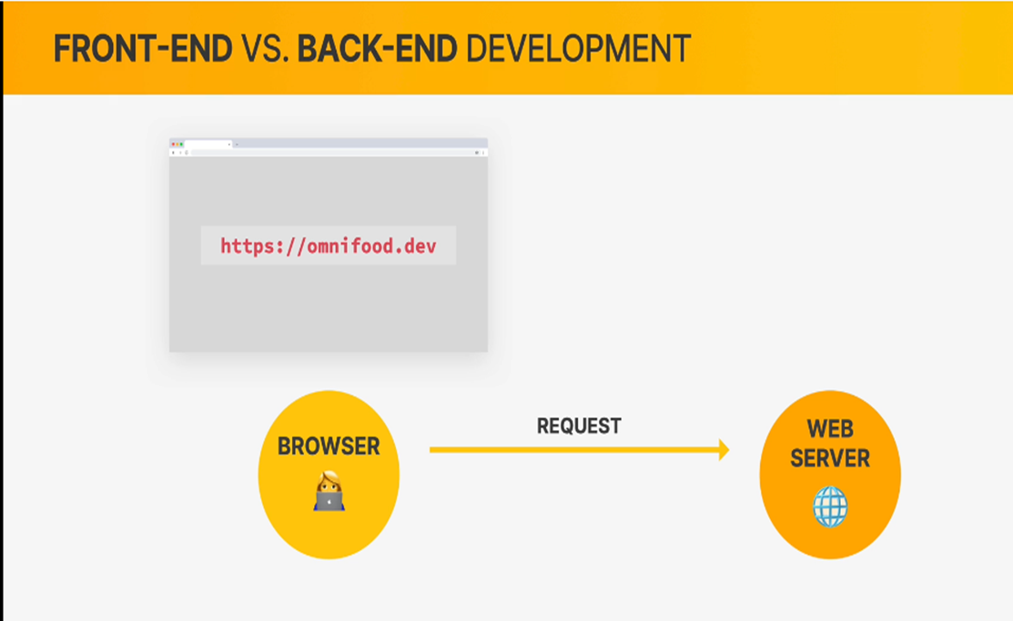
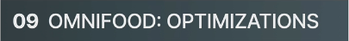
A HIGH-LEVEL OVERVIEW OF WEB DEVELOPMENT

Slide 4
A HIGH-LEVEL OVERVIEW OF WEB DEVELOPMENT
So again, when we browse to a certain website, our web browser will send a request to the server where the website is stored. So where it is hosted.

Slide 5
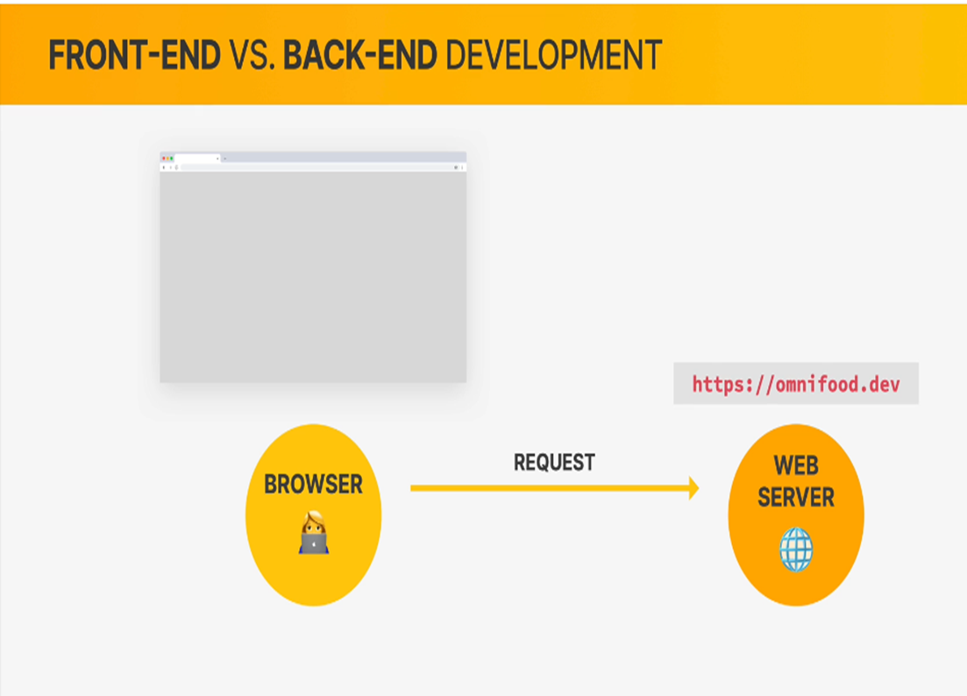
A HIGH-LEVEL OVERVIEW OF WEB DEVELOPMENT

Slide 6
A HIGH-LEVEL OVERVIEW OF WEB DEVELOPMENT
Then when the server receives the request, it will take all the files that make up the website and send them back to the browser. So, we say that the server sends responses to the browser which essentially contains all of these files that the website is made of.

Slide 7
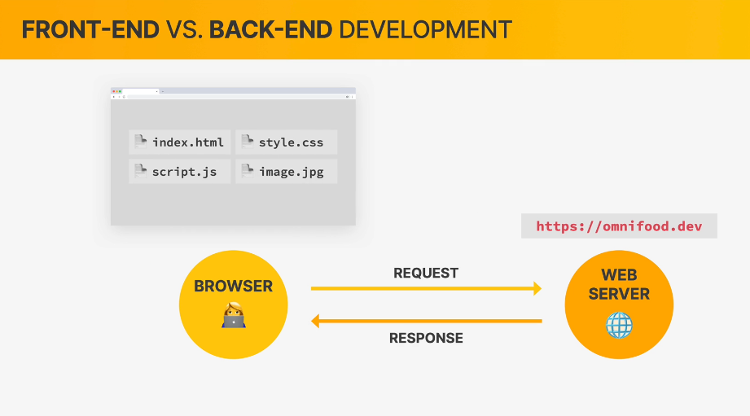
A HIGH-LEVEL OVERVIEW OF WEB DEVELOPMENT

Slide 8
A HIGH-LEVEL OVERVIEW OF WEB DEVELOPMENT
Now as we can see from these file extensions, we have some HTML, CSS, and also a JavaScript code here. And these are precisely the THREE LANGUAGES that browsers can understand.
So what this means is that all of the code that makes up a website needs to always be written in HTML, CSS and JavaScript. Because these are essentially the three core technologies that any browser can understand.

Slide 9
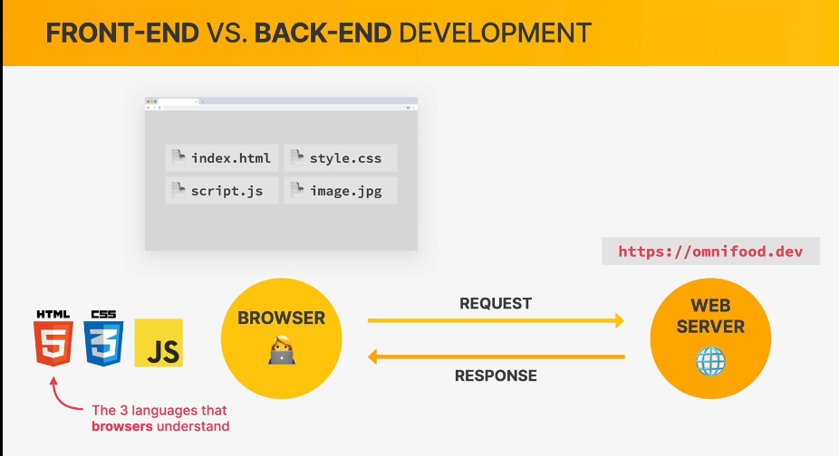
A HIGH-LEVEL OVERVIEW OF WEB DEVELOPMENT

Slide 10
A HIGH-LEVEL OVERVIEW OF WEB DEVELOPMENT
Once the browser receives these HTML, CSS and JavaScript files from the server’s response it will take the code and render the website that we’re trying to access based on that code.

Slide 11
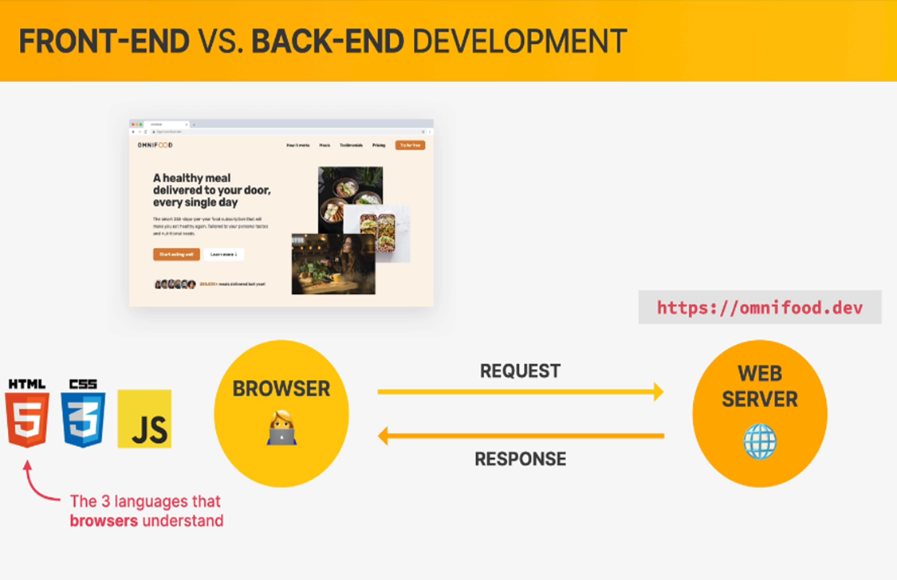
A HIGH-LEVEL OVERVIEW OF WEB DEVELOPMENT

Slide 12
A HIGH-LEVEL OVERVIEW OF WEB DEVELOPMENT
And with this, you already have a good understanding of what actually happens when we browser to a website and also about technologies that we use to build any website. So, that process of writing HTML, CSS and JavaScript code that the browser can understand is the process that we call Front-End Web Development. So, whenever you hear someone talking about Front-End Development, what they mean is developers writing the code that is displayed in a browser which is basically the front-end of a website. And in fact, this is essentially what we’re going to learn in this course.
At least the very fundamentals of front-end development,
which is learning HTML and CSS.

Slide 13
A HIGH-LEVEL OVERVIEW OF WEB DEVELOPMENT
Now just as a side note here, whenever the files that make up the website are simply stored on a web server and are then sent to the browser as they are, we say that we have a STATIC WEBSITE.

Slide 14
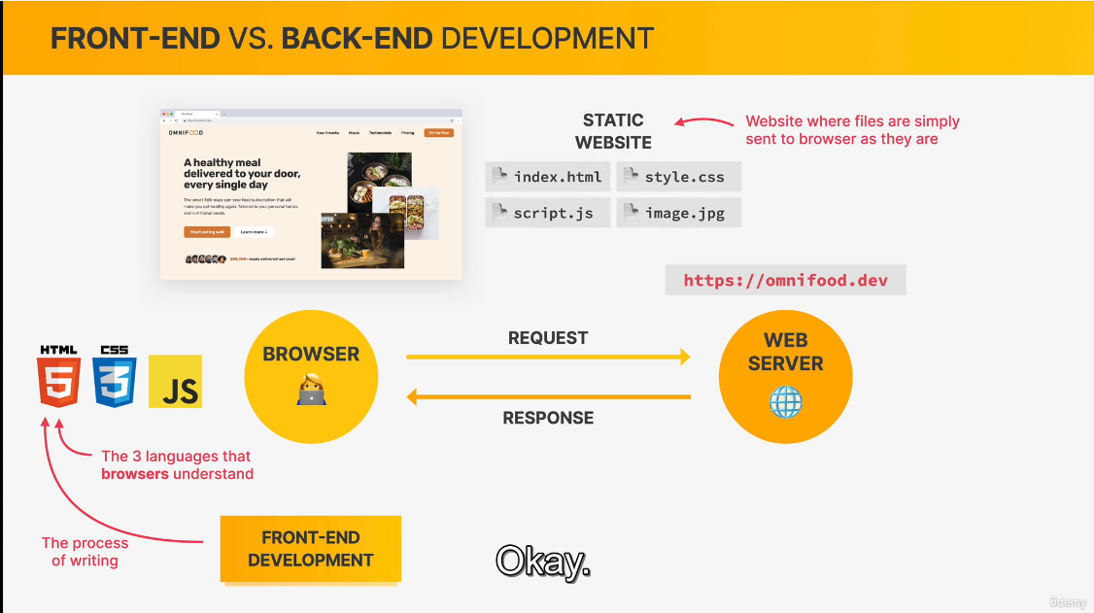
A HIGH-LEVEL OVERVIEW OF WEB DEVELOPMENT

Slide 15
A HIGH-LEVEL OVERVIEW OF WEB DEVELOPMENT
Just keep in mind that a static website is basically a website where the files are simply sent from the server to the browser as they are. So without any transformation.
Now let’s talk about something called Back-end Development by taking another example here. And this time let’s try to understand what would happen when we try to access a website like udemy.com, facebook.com, irembo.gov etc.

Slide 16
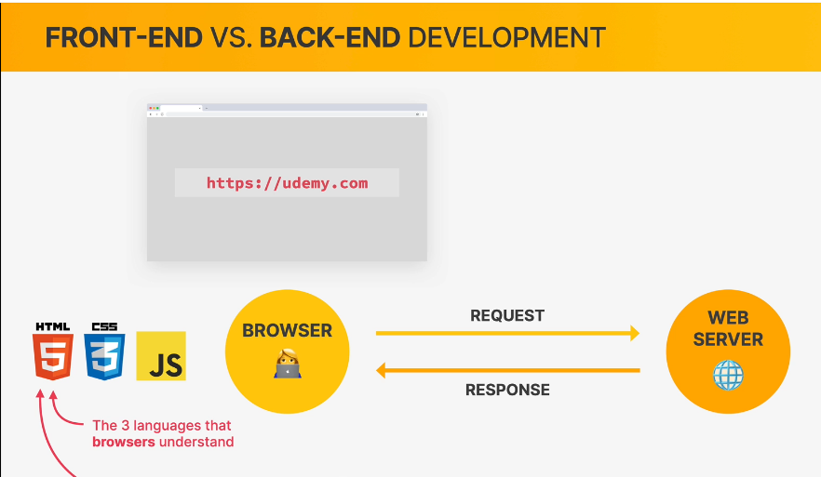
A HIGH-LEVEL OVERVIEW OF WEB DEVELOPMENT

Slide 17
A HIGH-LEVEL OVERVIEW OF WEB DEVELOPMENT
So once again, the first step is that a request is sent to the web server where Udemy.com is hosted. Now, why is a website like Udemy, so different from something like the static Omnifood website that we saw earlier? A complex site like Udemy.com is really completely different from a static site, because there is a lot of content that is always changing all the time.

Slide 18
A HIGH-LEVEL OVERVIEW OF WEB DEVELOPMENT
Like on udemy.com there are always new courses and new reviews being added to the site. And so, in order to make a system like this work, Udemy.com needs a whole application running on the server, and they also need a big database, which basically contains all the courses and all the reviews, all the users, and really all the content that is being displayed on the website.

Slide 19
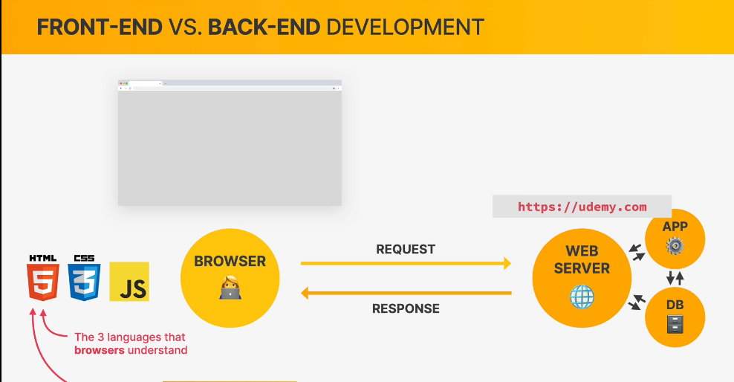
A HIGH-LEVEL OVERVIEW OF WEB DEVELOPMENT

Slide 20
A HIGH-LEVEL OVERVIEW OF WEB DEVELOPMENT
To do all this, Front-End technologies like HTML and CSS are simply not enough. So to write applications that are actually executed on web servers, developers use some kind of back-end languages like Node JS, PHP or PYTHON.

Slide 21
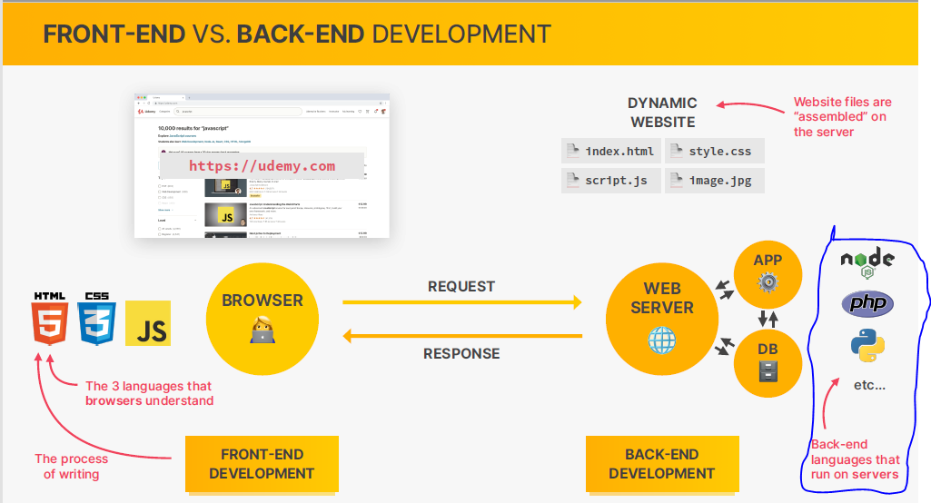
A HIGH-LEVEL OVERVIEW OF WEB DEVELOPMENT

Slide 22
A HIGH-LEVEL OVERVIEW OF WEB DEVELOPMENT
So what these languages do is to take data out of a database and assemble that data into the final files that will then be sent to the browser as the response. Therefore, this whole process is called Back-End Development because this is basically the invisible part of a website.

Slide 23
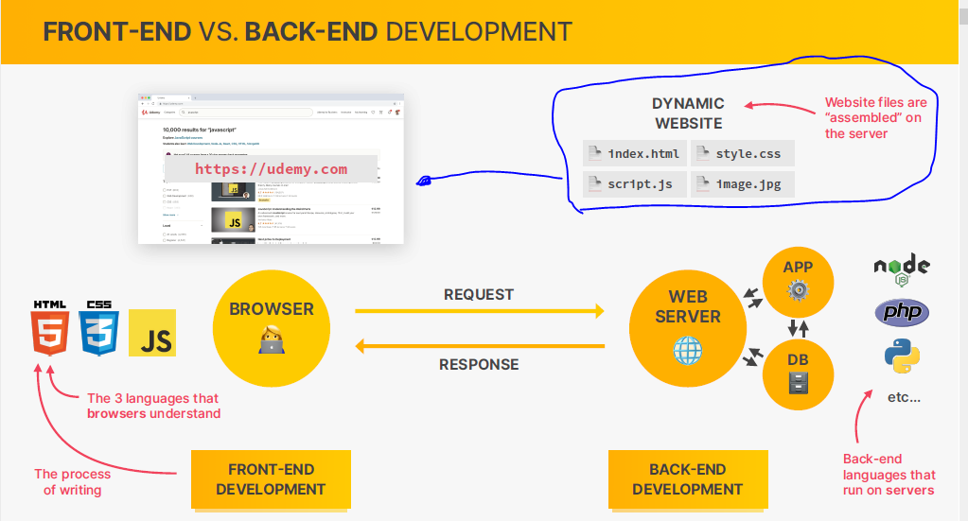
A HIGH-LEVEL OVERVIEW OF WEB DEVELOPMENT

Slide 24
A HIGH-LEVEL OVERVIEW OF WEB DEVELOPMENT
Now in this situation we say that we have a dynamic website because the website is dynamically assembled from different pieces on the server. And that happens each and every time that someone visits the website.
So returning to the example of Udemy.com, each time that you visit Udemy.com, a new version of the website is going to be generated from their database and sent to your browser.
Now, on the other hand, if Udemy were a static website, then the website files would already be sitting on the server, just waiting for someone to access them. So that the
difference between the static and dynamic website.

Slide 25
A HIGH-LEVEL OVERVIEW OF WEB DEVELOPMENT
In static, the files are already done, and in dynamic, they first need to be generated by an application that is running on the server.
But now, the rest of the process is actually the same as before. So these files are now ready to be sent to the browser as a response, which will be then converted to the final website like this one we see here on udemy.com

Slide 26
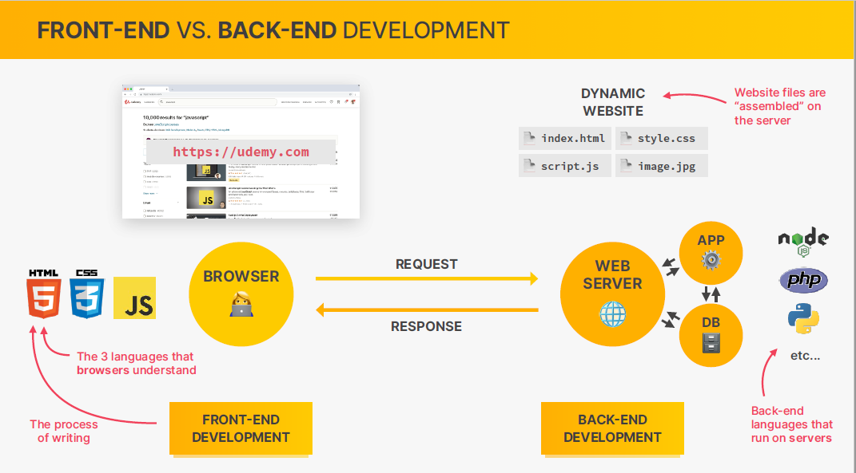
A HIGH-LEVEL OVERVIEW OF WEB DEVELOPMENT

Slide 27
A HIGH-LEVEL OVERVIEW OF WEB DEVELOPMENT
There is no need for you to memorize all these names that I mentioned here, and also no need to deeply understand this process. All I want here is to give you an overview of what front-end and back-end actually are, what the browser and the server are, and also what static and dynamic websites are because I really think that this is going to be extremely helpful as you start your developer journey.

Slide 28
A HIGH-LEVEL OVERVIEW OF WEB DEVELOPMENT
But now, just to finish, let’s take a closer look at the three languages of the front-end.

Slide 29
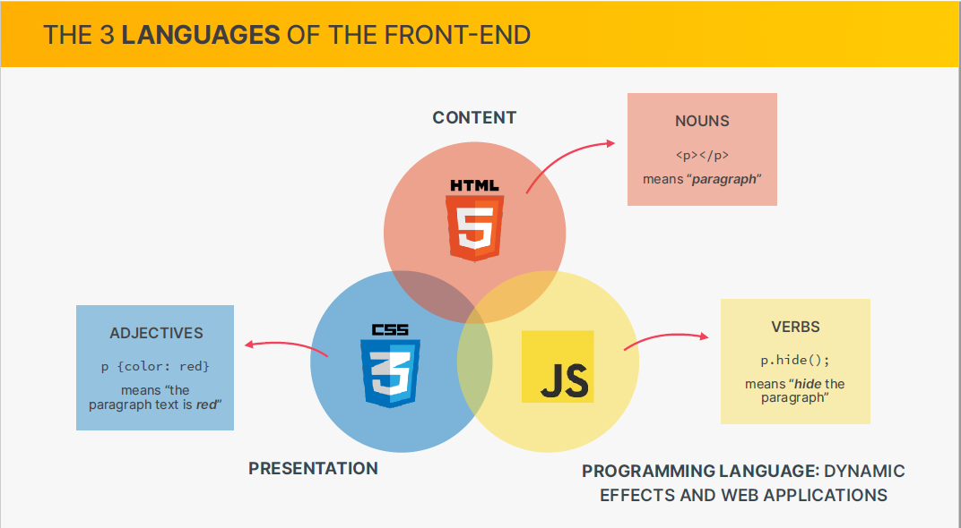
A HIGH-LEVEL OVERVIEW OF WEB DEVELOPMENT

Slide 30
A HIGH-LEVEL OVERVIEW OF WEB DEVELOPMENT
HTML is responsible for the content of the page. So that’s the text, the images, the buttons, and really all the content that you see on a webpage is always written inside an HTML file.
The CSS is responsible for the presentation of that content. Basically for styling and for laying out the elements on the webpage. And finally, JavaScript is the actual programming language of the front-end.

Slide 31
A HIGH-LEVEL OVERVIEW OF WEB DEVELOPMENT
So, it allows us to add dynamic and interactive effects to webpages. We can also use it to manipulate the content or the CSS to load data from web servers and even to build entire front-end applications which we then call web applications.

Slide 32
A HIGH-LEVEL OVERVIEW OF WEB DEVELOPMENT
Now we can also use the analogy of nouns, adjectives and verbs to make the separation of rules here a little bit easier to understand.
So, in this analogy, HTML represents the nouns. For example, saying that the p element is a paragraph. So paragraph is a noun here. The CSS then is the adjective because it basically describes the noun. For example, like this piece of CSS saying that the paragraph text is red. And so, red is the adjective describing the noun.
Finally, JavaScript is the verb, like saying hide the
Paragraph. So , we are actually doing something here.
And so we have a verb. Does that make a sense? So, with this,
We finish our introduction to web development.

Slide 33
SETTING UP OUR CODE EDITOR
Now before we can start writing a single line of code, we first need to install a special tool called a code editor.
This is in my opinion and the opinion of many other developers, the very best code editor for the web development in the world.
So, to download it , just go to code.visualstudio.com and
download it.

Slide 34
YOUR VERY FIRST WEBPAGE!
Let’s now write our very first line of code and build our very first and very small webpage.
Let’s create our project folder/root directory called 01-Test with index.html file inside our code editor. We call it index because that is the default name of the first page of any website. So, all web projects always need to have an index.html
We need an HTML structure to continue. Use ! Mark to
Get it. This one has the head and the body.
Change the title element to My first web page

Slide 35
YOUR VERY FIRST WEBPAGE!
Give to your h1 element the text Hello, world!
And your p element the text My name is Serge, and this is my first webpage: D
Congratulations and well done on your very first webpage.
Put your vscode on left and your website on right to always see the changes

Slide 36
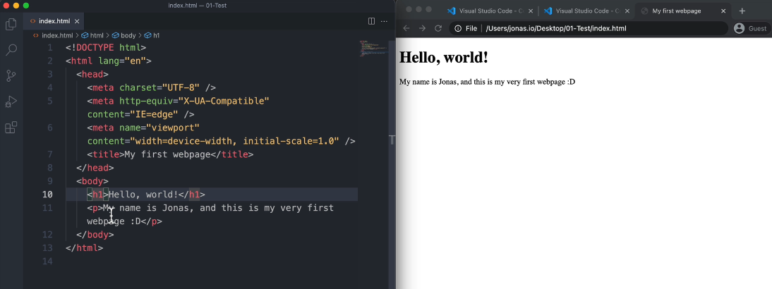
YOUR VERY FIRST WEBPAGE!

Slide 37
YOUR VERY FIRST WEBPAGE!
I’m using Google Chrome to test all the codes that we are going to write throughout this course. So I really advise you to always use Google Chrome to text the code that you’re writing.
Summary
Create a project folder and name it
Open up that project folder in Vs code
Inside that folder create an index.html file
Add some codes to that file

Slide 38
YOUR VERY FIRST WEBPAGE!
Finally , open up the HTML document in a real browser
such as Google Chrome, where we then see this result.
Basically the translation of our code to a visual result.

Slide 39
HTML FUNDAMENTALS
HTML stands for Hypertext Mark up language.
HTML is a mark up language that web developers use to structure and describe the content of a webpage(not a programming language)
HTML consists of elements that describe different types
of content: paragraphs, links, headings, images, video
etc.
Web browsers understand HTML and render HTML code as
websites

Slide 40
HTML FUNDAMENTALS
ANATOMY OF AN HTML ELEMENT
An html element is usually made up of three parts. First , the opening tag which is the name of the element. In this case it is p wrapped in greater and less than symbols. <p>
Then after that, we have the content of the element.
And finally we have the closing tag but with a slash.
HTML has also what we call self closing tags. It means the tags
That don’t have closing tags. For instance, <img>

Slide 41
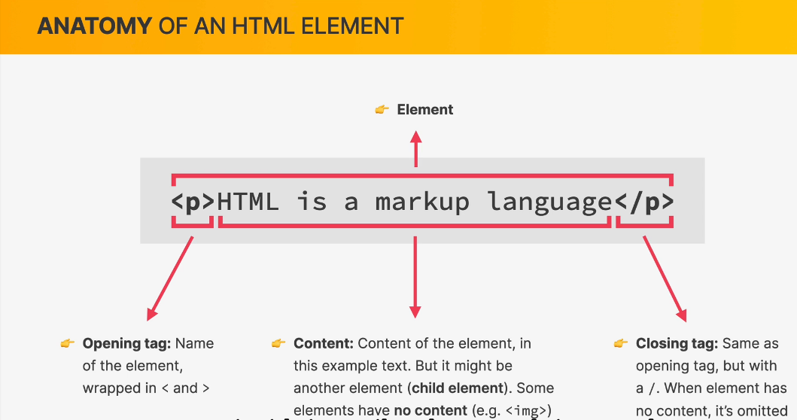
HTML FUNDAMENTALS

Slide 42
HTML FUNDAMENTALS
HTML DOCUMENT STRUCTURE
Let’s start our html project.
Open your starter folder which is 02-HTML-Fundamentals in your vs code from your desktop.
Create your index.html with the html structure.
Put your vs code on left side and your browser on right
Side.

Slide 43
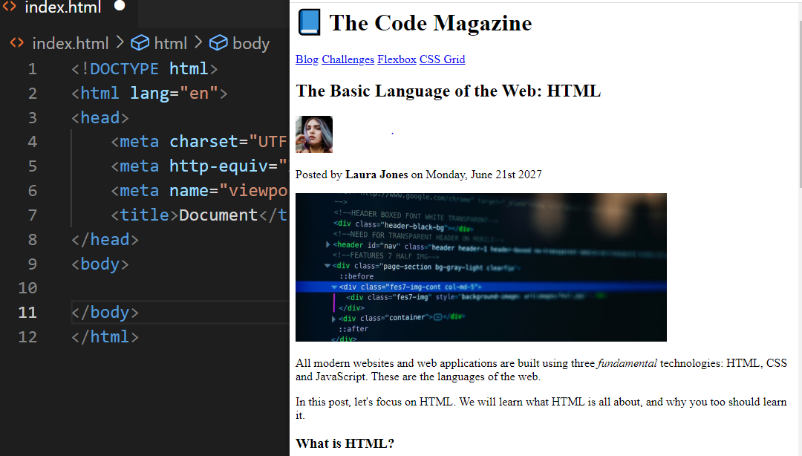
HTML FUNDAMENTALS

Slide 44
HTML FUNDAMENTALS
HTML DOCUMENT STRUCTURE
Inside of our root directory we have some pictures and a content file.
So let’s create an html structure and give to the title the following text:
The Basic Language of the Web: HTML
And an h1 element :
The Basic Language of the Web: HTML

Slide 45
HTML FUNDAMENTALS
TEXT ELEMENTS
In this lecture we will continue learning how to mark up texts.
So we will keep using some headings, some paragraphs, and we will also learn how to make texts bold and italic.
We have 6 headings in html.
Use h1 to h6 element and make headings with the
Following text:
The Basic Language of the Web: HTML

Slide 46
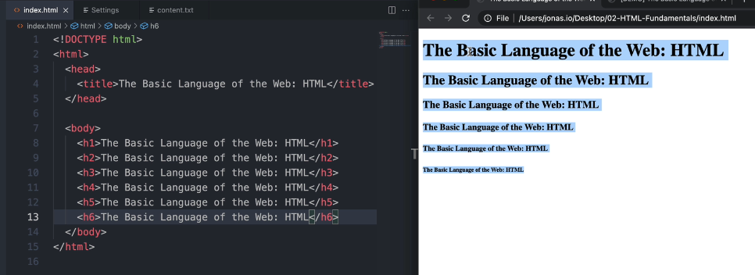
HTML FUNDAMENTALS
TEXT ELEMENTS

Slide 47
HTML FUNDAMENTALS
TEXT ELEMENTS
If we analyze our Code magazine we can find some headings
h1 (The code magazine)
h2 (The Basic Language of the Web: HTML)
h3(What is HTML?)
Let’s go to our content file and copy texts from the first heading
📘 The Code Magazine, the second and the third heading

Slide 48
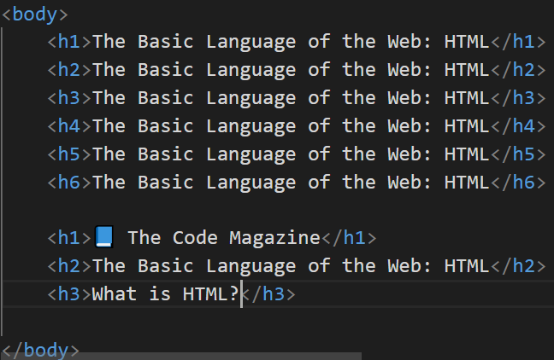
HTML FUNDAMENTALS
TEXT ELEMENTS

Slide 49
HTML FUNDAMENTALS
TEXT ELEMENTS
Create the first paragraph under h1 and give it the text :
Posted by Laura Jones on Monday, June 21st 2027 from content file.
Make another paragraph under h2 with the texts
All modern websites to the web.
Make the second paragraph under h2 with the text from
In this post to learn it.
Then after h3 make 2 paragraphs. With the following texts
The first p: HTML stands for – (not a programming language)
The second p: HTML consists of – as websites.

Slide 50
HTML FUNDAMENTALS
TEXT ELEMENTS
Now to clean up the six headings, let’s now actually get rid of them.
So now you already know how they work and that they exist.
Actually instead of getting rid of them, we can use something called “comments” in HTML.
So, a comment in html is a way of writing some code that will
Not be visible in the browser. And this is very useful
Because it allows us to write comments about our code,
Or also to simply hide some code that we do not want to
be rendered on the browser.

Slide 51
HTML FUNDAMENTALS
TEXT ELEMENTS
So to write a comment hold Ctrl Key + /
As we want to comment all the six headings , we have to select
Them and then apply the short cut above.
Make another h3 with (why should you learn HTML?)
So to finish , let me show you how we can make italic and
Bold some texts.

Slide 52
HTML FUNDAMENTALS
TEXT ELEMENTS
So to write a comment hold Ctrl Key + /
As we want to comment all the six headings , we have to select
Them and then apply the short cut above.
Make another h3 with (why should you learn HTML?)
So to finish , let me show you how we can make italic and
Bold some texts.

Slide 53
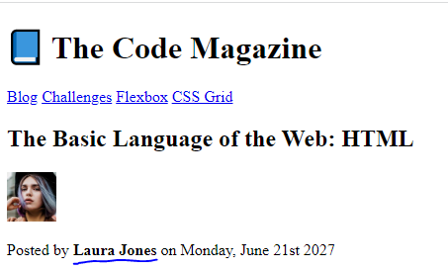
HTML FUNDAMENTALS
TEXT ELEMENTS
So, we have this name of the author , witch is “Laura Johns” in bold. How can we do that in HTML?

Slide 54
HTML FUNDAMENTALS
TEXT ELEMENTS
We can use <b></b> however the use of <b> is not a good practice because it is an old HTML element and starting in HTML 5, we should always use the strong element instead of “b”.
The reason of that is that b doesn’t have any semantic meaning, it is just an element without a specific meaning.
While on the other hand the strong element means that this is
really an important element that we want to stand out
From the page. So, use <strong></strong> and it will look
The same.

Slide 55
HTML FUNDAMENTALS
TEXT ELEMENTS
Let’s make the word fundaments italic.
Just like with b , there are actual two ways of doing it. The older one is the “i” element, but in order to make it semantic we should use “em” element which stands for Emphasize. So , we want to emphasize the text “fundamentals” and that is the reason we make it italic.
Great! This is great progress!

Slide 56
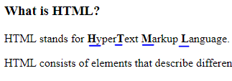
HTML FUNDAMENTALS
TEXT ELEMENTS
Now , just to finish this lecture, I actually already want to give you your very first small coding challenge.
I want you to make the first letter Bold.
HyperText Markup Language.

Slide 57
HTML FUNDAMENTALS
MORE TEXT ELEMENTS: LISTS
In HTML we have two types of lists:
Ordered list
Unordered list
The syntax is
<ul></ul> : unordered list + nest the list items <li></li>
<ol></ol> : ordered list + nest the list <li></li>

Slide 58
HTML FUNDAMENTALS
MORE TEXT ELEMENTS : LISTS
In this lecture we will learn how to create lists with bullet points and also with numbers. (open the demo)
Under the paragraph HTML consists of element etc.
Create another paragraph with the below content:
In HTML, each element is made up of 3 parts:
Then create an ordered list like on the code magazine.
Copy the texts from contents file

Slide 59
HTML FUNDAMENTALS
MORE TEXT ELEMENTS : LISTS
Under h3 Why should you learn html, create an unordered list like on the code magazine.
Copy the texts from contents file

Slide 60
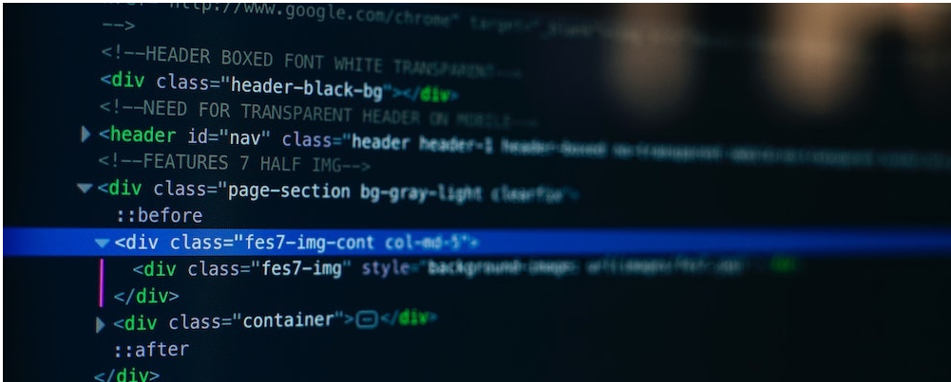
HTML FUNDAMENTALS
IMAGES AND ATTRIBUTES
We are going to upload the post image on our website

Slide 61
HTML FUNDAMENTALS
IMAGES AND ATTRIBUTES
We want the image after the author Laura Jone.
Note that img element doesn’t have contents and it is a self-closing element.
Synthax
<img src="" alt=“HTML code on a screen"/>
Src is an attribute. So, attributes are pieces of data which
We can use to describe elements. Here we are describing
the source from which the browser should basically read the
the image.

Slide 62
HTML FUNDAMENTALS
IMAGES AND ATTRIBUTES
Alt : is another attribute that stands for alternative text.
It will describe what the image is about.
This is very important for various reasons:
One of them is that it will allow search engines, such as
Google Chrome, to actually know what is in the image,
Because without this description, search engines don’t
Really have a know of knowing what the image is actually
about.

Slide 63
HTML FUNDAMENTALS
IMAGES AND ATTRIBUTES
Another use case of alt is that whenever the image fails to load due to syntax errors the user might see the text.(HTML code on a screen)
We can specify some more attributes which are quite important in this case. The image width and the image height.
The image is very big, let’s specify the width of 500 &
Height of 200. width=“500” height=“200”
500 and 200 are pixels, and we will see this in CSS.

Slide 64
HTML FUNDAMENTALS
IMAGES AND ATTRIBUTES
Code challenge:
Between The basic language of the web and posted by Laura Jones , upload laura-jones.jpg picture.
Give the picture the width of 50 and height 50.
Alt : Headshot of Laura Jones.

Slide 65
HTML FUNDAMENTALS
HYPERLINKS
One of the fundamental building blocks of the internet are hyperlinks or for short , just links.
Links are what actually enables the internet to be a worldwide web. So without links between pages there would be no web.
And so let’s now learn how to place links on our own
Webpages.

Slide 66
HTML FUNDAMENTALS
HYPERLINKS
Now, we can place links into two big categories.
The first category is links that point to other pages within our own website. So, let’s say that here in our website, The code magazine, we had another blog post. So we could then create
a link from this page to that other page.

Slide 67
HTML FUNDAMENTALS
HYPERLINKS
Now, on the other hand, the other category is links that point to outside of our website.
So , for example if I placed a link to YouTube here on this page, then, that’s of course, would be a link to the outside of our website.

Slide 68
HTML FUNDAMENTALS
HYPERLINKS
So, for example if I placed a link to youtube.com here on this page, then, that of course, would be a link to the outside of our website. Another one is MDN Web docs(a website where you can learn all about html, css and Javascript).
Let’s grab the link of MDN web docs.
Google mdn html (Mozilla development network)
Copy the URL.

Slide 69
HTML FUNDAMENTALS
HYPERLINKS
Create a link after the ordered list then use your url(check the demo)
The text to be used is MDN Web docs.
Nest your link into a paragraph
<p> You can learn more at <a></a> </p>
Here we navigate directly to MDN page and our own page
Disappeared.

Slide 70
HTML FUNDAMENTALS
HYPERLINKS
And we can go back to the main page. To avoid this, we can open a link to a new tab by adding an attribute to the link target=“_blank”. This will open the link in a new tab and our original one is still open.
Now let’s link to an internal page.
Look at the demo, we have Blog, challenges, Flexbox,
CSS Grid.
Let’s create the first link blog and a new page to link to.

Slide 71
HTML FUNDAMENTALS
HYPERLINKS
Create a file and call it blog.html
Give the title BLOG
h2 BLOG
Create a link under h1: The code magazine.
Give to the attribute href=“blog.html”
You can create another link on blog page that points back
to index.html, with the text Back to home(Do this challenge, I give you 3 minutes.)

Slide 72
HTML FUNDAMENTALS
HYPERLINKS
To finish, we can specify a link that does not go anywhere
Let’s try it with Challenges, Flexbox, CSS Grid.
This is simple. Just create a link give the attribute href a # symbol then add the text between the <a> tags like Challenges, Flexbox, and CSS Grid.
Note that when you click to these pages the go anywhere
but send you to the top of the page.

Slide 73
HTML FUNDAMENTALS
STRUCTURING OUR PAGE(HTML 5 Elements)
The page is lacking some structure. If we look at all the elements we have been using, they appear one after another.
They’re not really distinguished form one another, and especially they’re not grouped together in any logical way.
And so, let’s change that by creating some container elements, which will then group these elements together.

Slide 74
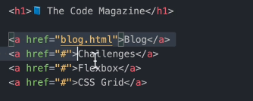
HTML FUNDAMENTALS
STRUCTURING OUR PAGE(HTML 5 Elements)
So, one of the things that first come to mind is the links.

Slide 75
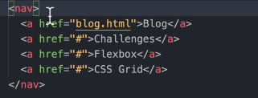
HTML FUNDAMENTALS
STRUCTURING OUR PAGE(HTML 5 Elements)
All these links look like a page navigation. So, a page navigation is usually what we want, when we have a couple of links at the top of a page. And what we can do is to specify a special element, and then place all the links into that element. And the element that I mean is called <nav>, which stands for navigation.

Slide 76
HTML FUNDAMENTALS
STRUCTURING OUR PAGE(HTML 5 Elements)
Now the thing is that when we update our page, it does look exactly the same. So, all that happens here, is that this basically created like an invisible box, which contains the elements(links).
The element nav on itself doesn’t do anything, all it does
Is to group the links together. Now, it’s like there is no
need of using the container element(nav) but when we
Start using CSS it will be very important to use it.

Slide 77
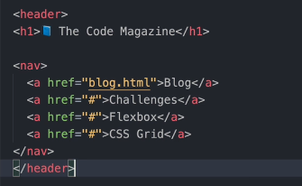
HTML FUNDAMENTALS
STRUCTURING OUR PAGE(HTML 5 Elements)
We can also group the navigation and the heading h1 into a header element. A header means a top part of a web document, or it can also mean the top part of some smaller unit, as we will see in a minute.

Slide 78
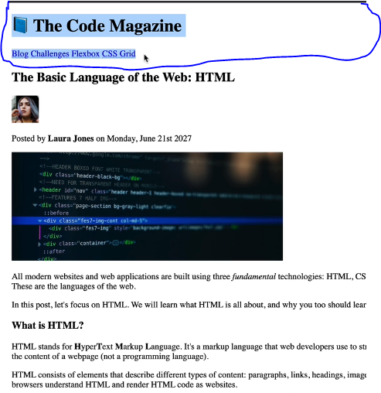
HTML FUNDAMENTALS
STRUCTURING OUR PAGE(HTML 5 Elements)
Again, nothing will change visually, but we told the browser like, “Hey, all of this here is our webpage header”

Slide 79
HTML FUNDAMENTALS
STRUCTURING OUR PAGE(HTML 5 Elements)
So, it’s the top part of our page.
Let’s now put all the remaining part of our webpage into the article element.
<article>
<h2>The basic language of Web:HTML</h2>
…….
<p>Hopefully you learned something new here. See you
Next time</p>
</article>

Slide 80
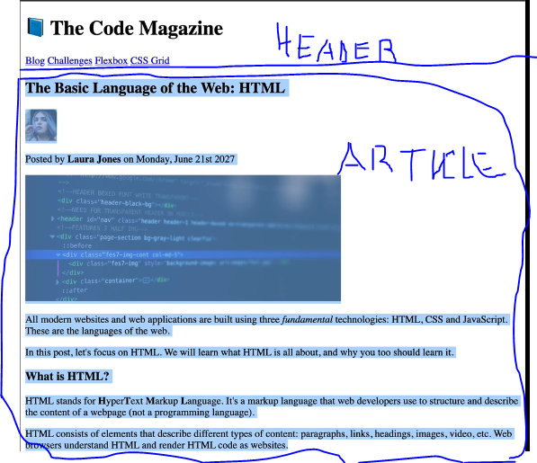
HTML FUNDAMENTALS
STRUCTURING OUR PAGE(HTML 5 Elements)
So now, basically, our body has only two direct child elements. We only have a header and we have an article.

Slide 81
HTML FUNDAMENTALS
STRUCTURING OUR PAGE(HTML 5 Elements)
Nicely placed inside of its own box. So , one thing that you might ask, Well, if these boxes, all of them don’t do anything , why don’t we call of them just nav, or all of them header, or all of them article? Header could be called article and nothing could change on the page? However we don’t do that for something called Semantic HTML. I will explain it briefly very soon.

Slide 82
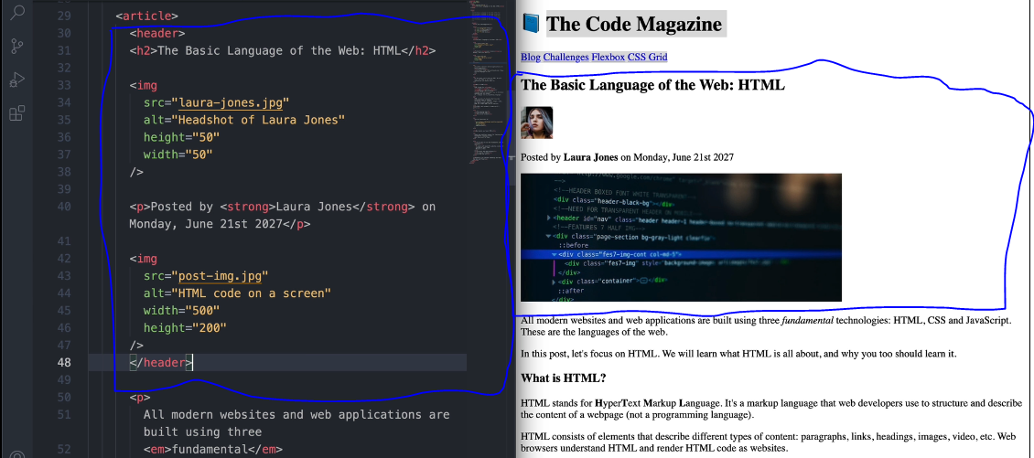
HTML FUNDAMENTALS
We can also group the top of our article within a header.

Slide 83
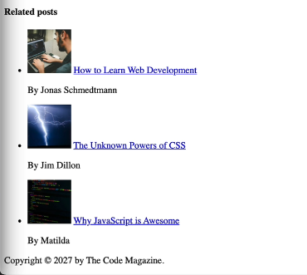
HTML FUNDAMENTALS
If we look at the demo , we don’t have these related posts yet,

Slide 84
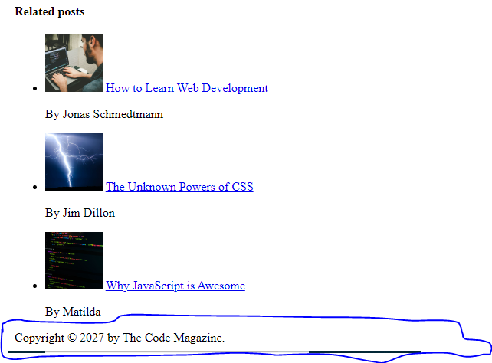
HTML FUNDAMENTALS
But we also have this part here at the bottom. And this kind of the content that comes at the very end of a page is what we usually call the footer.

Slide 85
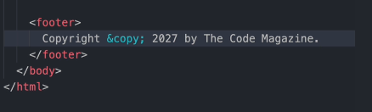
HTML FUNDAMENTALS
Create a footer and add an HTML entity which is @

Slide 86
HTML FUNDAMENTALS
As I said, it is very important to group the content into logical parts , which is important for Semantic HTML, and also for styling with CSS as we will see in next chapter.

Slide 87
HTML FUNDAMENTALS
A NOTE ON SEMANTIC HTML
In HTML when we talk about semantics, what we mean is that certain elements have actually a meaning or a purpose attached to them. When we thing about a certain HTML element, we should actually not thing about what that element looks like as it’s rendered on the page. But instead we should think about what that element actually means and what it stands for. So
that is basically the definition of semantic HTML. Now,
not all elements in HTML are semantic.

Slide 88
HTML FUNDAMENTALS
A NOTE ON SEMANTIC HTML
In previous sections we used strong element which means that we want to make it bold. This actually means that we need a strong content or a very important piece of content.
The same thing with em element , it meant that we gave it a special
emphasis on the content fundamental. We emphasized on
That content.
Even when we used nav element, we wanted to mean that
The content within the nav element are navigation items. The
same thing with the paragraph, article, header and footer.

Slide 89
HTML FUNDAMENTALS
A NOTE ON SEMANTIC HTML
The paragraph is also an invisible box. But we could use a generic box without any meaning like div and nothing would change visually.
We use semantic HTML to give our element a meaning.
You might ask why we actually do that? There are multiple
reasons. One of them is Search engine optimization,
Which basically means, a search engine search as Google

Slide 90
HTML FUNDAMENTALS
A NOTE ON SEMANTIC HTML
Will be able to understand the structure of your content, and therefore, they will be better able to analyze what your content and what your webpage is all about.
Also writing semantic HTML is extremely important for
Accessibility and especially for people who rely on screen
Readers to consume on web pages.

Slide 91
HTML FUNDAMENTALS
INSTALLING ADDITIONAL VS CODE EXTENTIONS
Additional extensions make our lives a little bit easier as we code HTML and CSS.
The first one is image previe: Search it and enable it if it is disabled. This displays the image in vs code.
Color highlight: is also helpful for visualizing colors in CSS
Auto rename tag: This helps us when we change a name of
an element it automatically changes the closing tag.
For example change the <header> element to div. just change
The opening tag and the closing one will automatically change.

Slide 92
HTML FUNDAMENTALS
INSTALLING ADDITIONAL VS CODE EXTENTIONS
An other one, go to the settings
Type auto close tag
Enable it
We allow vs code to close the tags automatically.

Slide 93
HTML FUNDAMENTALS
INSTALLING ADDITIONAL VS CODE EXTENTIONS
Now we are going to install the most important and the most
Useful one of all, and that is called LIVE SERVER.
Live server with almost 12 millions downloads and it is popular for a reason.
Enable it and go to your HTML down to the bottom on the status bar, you will find a button call go live. When you click on it, you starts a server and will get the message
Server is started at port:5500

Slide 94
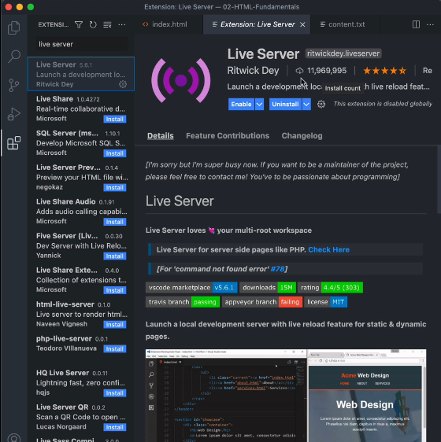
HTML FUNDAMENTALS

Slide 95
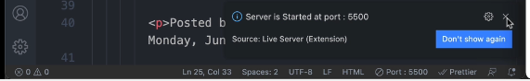
HTML FUNDAMENTALS

Slide 96
HTML FUNDAMENTALS
LIVE SERVER helps to automatically update a page. There is no longer a need of refreshing your webpage. All you have to do is to save your code in vs code and then the output will update automatically.

Slide 97
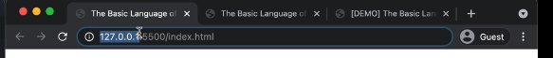
HTML FUNDAMENTALS
This one means it’s a local host server.
You have your web server on your own computer running.

